Slide 1
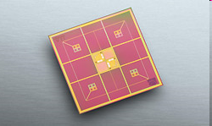
DETEKTOROK
SQUID
(Super-conducting Quantum Inter-ference Device) in a
YBa2Cu3O7-SrTiO3-YBa2Cu3O7
multilayer technology.
A magnetic field of 100fT (femto-tesla: 10-15 tesla) to several tens of is emitted from the heart. The earth's magnetic field is approximately 50µT (10-6 tesla),
thus the heart's magnetic field is approx. 1/1,000,000 that of the earth's field.
cooled to the temperature of :
Liquid Helium (about -273°C), can measure these tiny magnetic fields ( 4,2 Kelvin ),
Liquid Nitrogén -196°C ( 77 Kelvin ).

Slide 2
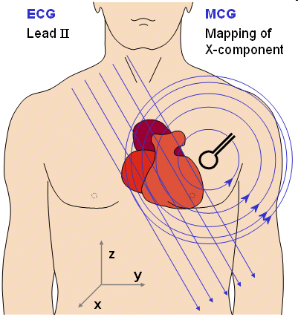
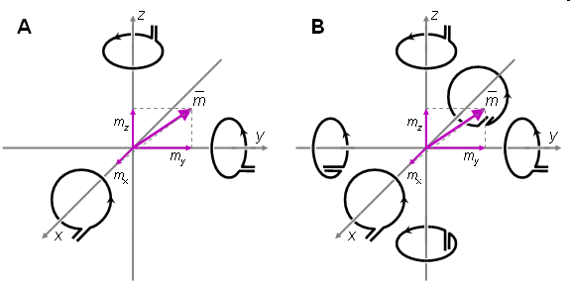
A natural method to measure the magnetic dipole moment of a source locating in the origin is to measure the x-, y-, and z-components of the magnetic field on corresponding coordinate axes. These may be either (A) unipolar or (B) bipolar measurements. www.bem.fi/book/20/20.htm
Magnetocardiography MCG

Slide 3
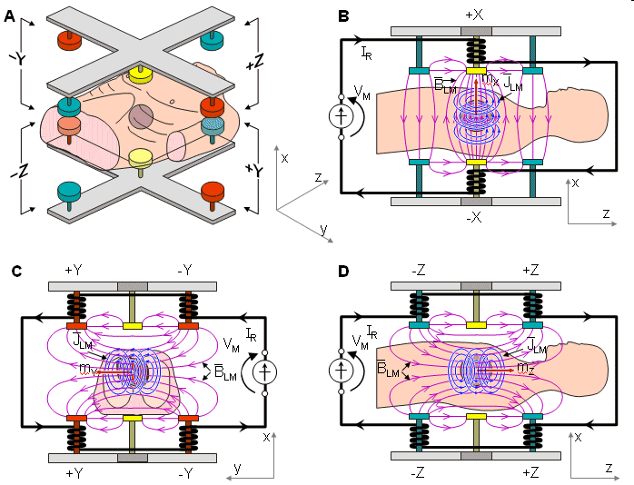
Magnetocardiography MCG

Slide 4
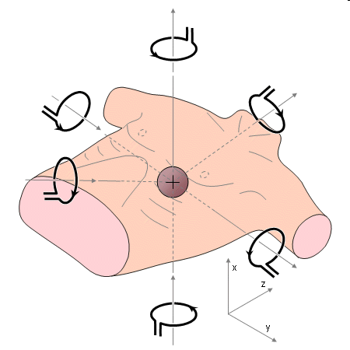
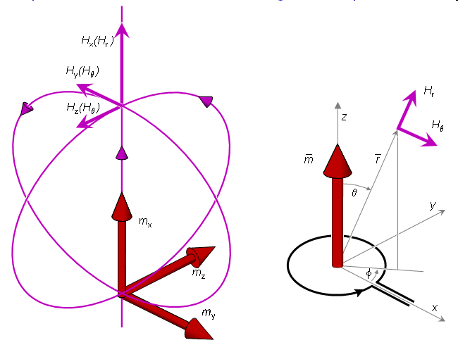
Symmetric XYZ lead system.
Magnetocardiography MCG
(A) The three components Hx, Hy, and Hz of the magnetic field due to the three components mx, my, and mz of a magnetic dipole .
(B) Components of the magnetic field of a dipole.
(A) (B)

Slide 5
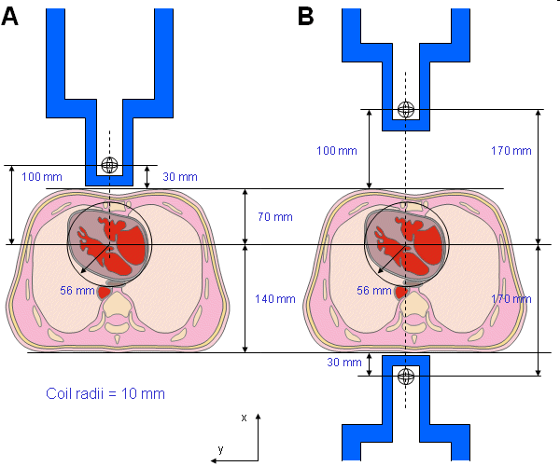
Dimensions for the thorax and heart models and the measurement distances in unipolar and bipolar unipositional measurements.
(A) Unipolar (nonsymmetric) measurement location on the anterior side.
(B) Bipolar (symmetric) measurement locations on the anterior and posterior sides.
Magnetocardiography MCG

Slide 6
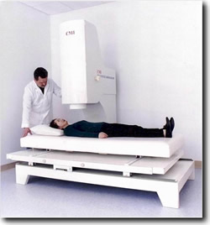
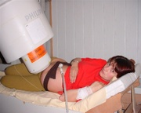
Magzati EKG
Magnetocardiography MCG

Slide 7
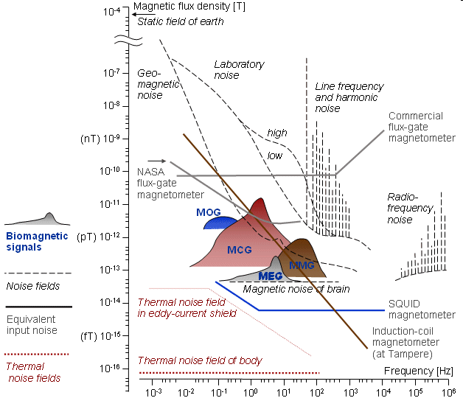
ZAJ SPEKTRÁLIS jellemzése

